Slide 1
Multimedia Systems Lecture – 17
By
Dr. Priyambada Subudhi
Assistant Professor
IIIT Sri City

Slide 2
Characteristics of Sound
The sound wave is having the following characteristics
Amplitude:
It refers to the distance of the maximum vertical displacement of the wave from its mean position.
In sound, amplitude refers to the magnitude of compression and expansion experienced by the medium the sound wave is travelling through.
This amplitude is perceived by our ears as loudness. High amplitude is equivalent to loud sounds.
Wavelength:
A sound wave is made of areas of high pressure alternated by an area of low pressure.
The high-pressure areas are represented as the peaks of the graph. The low-pressure areas are represented as troughs of the graph.
The physical distance between two consecutive peaks in a sound wave is referred to as the wavelength of the sound wave.

Slide 3
Frequency/ Pitch of the Sound Waves
Frequency in a sound wave refers to the rate of the vibration of the sound travelling through the air. This parameter decides whether a sound is perceived as high pitched or low pitched.
In sound, the frequency is also known as Pitch.
The frequency of the vibrating source of sound is calculated in cycles per second (Hertz).

Slide 4
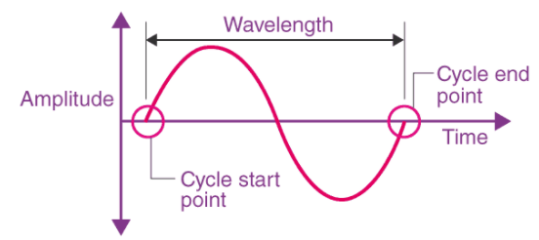
A depiction of Sound Waves in Waveform

Slide 5
Digitization
Since there is only one independent variable in sound i.e. time, we call this a 1D signal—as opposed to images, with data that depends on two variables, x, and y.
The amplitude value is a continuous quantity. To fully digitize the sound signal, we have to sample in time and in amplitude.
Sampling means measuring the quantity we are interested in, usually at evenly spaced intervals.
The first kind of sampling—using measurements only at evenly spaced time intervals—is simply called sampling and the rate at which it is performed is called the sampling rate or sampling frequency.

Slide 6
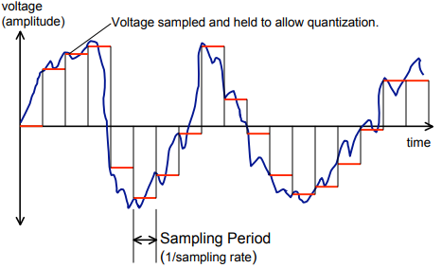
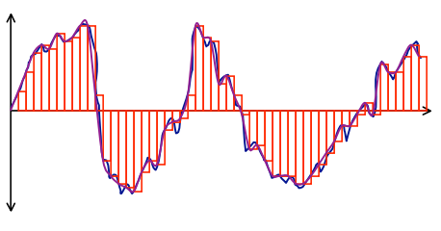
Sampling

Slide 7
For audio, typical sampling rates are from 8 kHz (8,000 samples per second) to 48 kHz.
The human ear can hear from about 20 Hz to as much as 20 kHz; above this level, we enter the range of ultrasound.
The human voice can reach approximately 4 kHz.
Nyquist sampling rate :
To preserve the full information in the signal, it is necessary to sample at twice the maximum frequency of the signal. This is known as the Nyquist rate.
If we sample the signal at a frequency that is lower that the Nyquist rate, when the signal is converted back into a continuous time signal, it will exhibit a phenomenon called aliasing. Aliasing is the presence of unwanted components in the reconstructed signal.

Slide 8
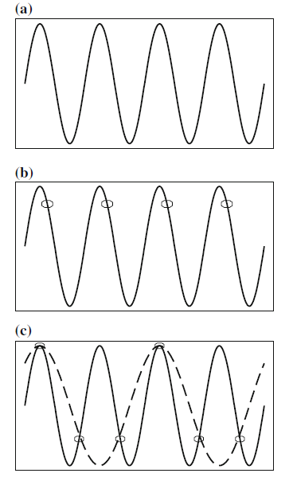
Aliasing: a ) a single frequency; b ) sampling at exactly the frequency produces a constant; c) sampling at 1.5 times per cycle produces an alias frequency that is perceived

Slide 9
Quantization:
Sampling in the amplitude or voltage dimension is called quantization or It refers to the process of transforming a sampled analog signal, to a digital signal, which has a discrete set of values.
While we have discussed only uniform sampling, with equally spaced sampling intervals, non-uniform sampling is possible. This is not used for sampling in time but is used for quantization.
Typical uniform quantization rates are 8-bit and 16-bit; 8-bit quantization divides the vertical axis into 256 levels, and 16-bit divides it into 65,536 levels.
Quantization Error: A digitized sample can have a maximum error of one-half the discretization step size.

Slide 10
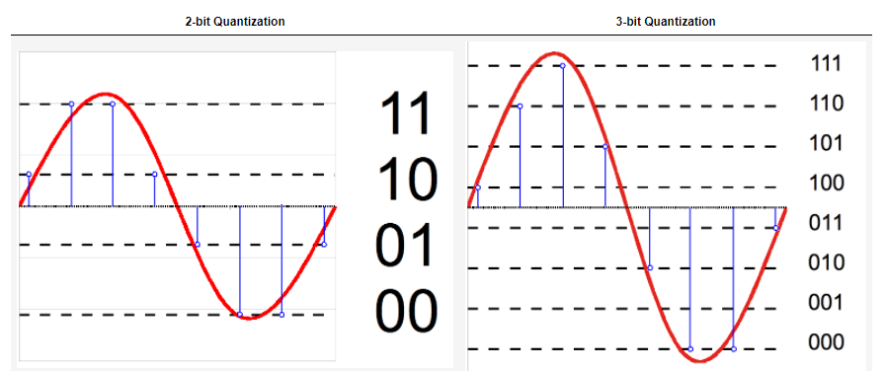
2-bit and 3-bit Quantization

